Slide 1
Object-Oriented Programming
Kevin Wang

Slide 2
Slides:
links.cs61a.org/kevin-slides

Slide 3
Administrivia
HW 5 Due tomorrow!
Ants due next Thursday 3/14
Phase 1 & 2 due Monday 3/11
Partners
Midterm 2 coming up!

Slide 4
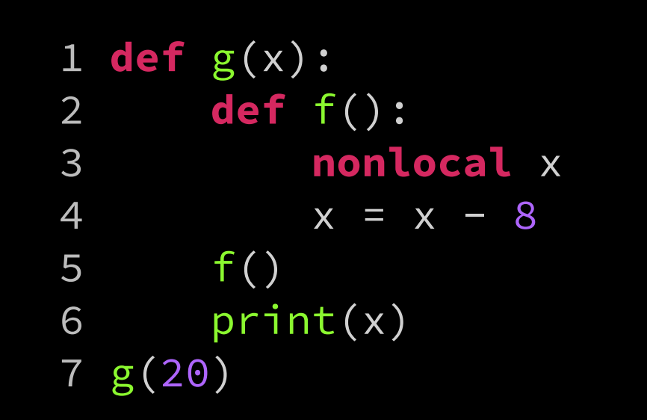
Correction from last time:

Slide 5
OOP

Slide 6
Why OOP?
More abstraction!
Can now define our own types of data to work with!
Reuse code through inheritance
You’ve already been using classes!
Ex: lists, list.append

Slide 7
Some terminology
Class - A “template” for an object
Object - An instance of a class
Attributes:
Instance Attributes: property that is specific to an object
Class Attributes: property that is shared between all instances of the class.
Method - A function that is bound to a particular class

Slide 8
Difference between functions and methods?
Methods must take in an additional argument “self”.
The “self” argument tells the method which object to work with, so we know where to go to look up variables and methods.
Class.method(self, args)
object.method(args)

Slide 9
Inheritance
Subclasses can inherit their parent class’ attributes and methods.
Just like how we look up variables in our parent frames in environment diagrams
If Pet is the superclass, and Cat is a subclass of Pet, then we can say that a Cat is a Pet, but a Pet is not a Cat

Slide 10
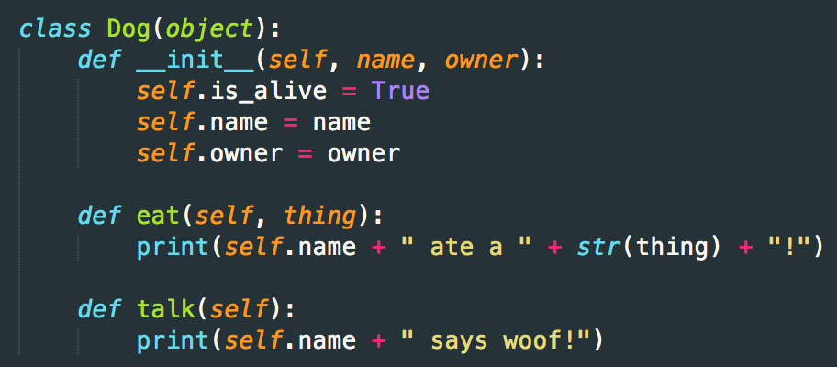
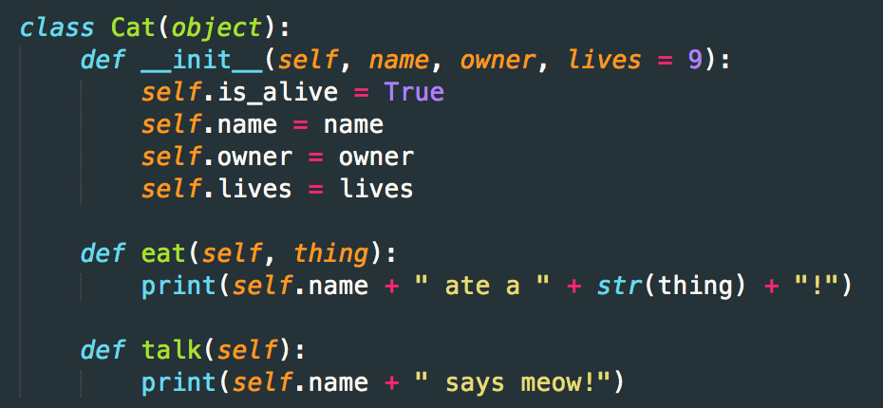

Slide 11
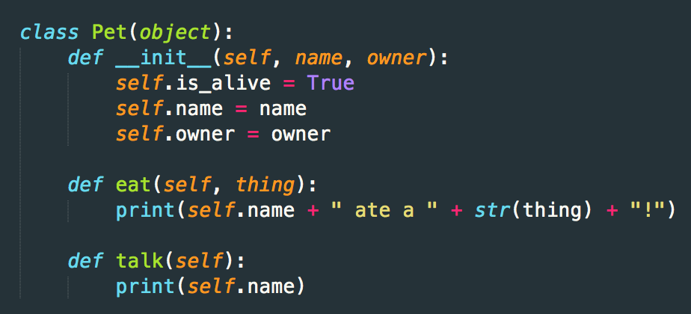
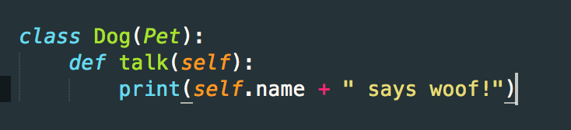

Slide 12
Demo

Slide 13
Worksheet!

Slide 14
Attendance!
links.cs61a.org/kevinwang-disc

Slide 15
links.cs61a.org/kevin-disc

Slide 16
Exam Level Question Spring 2015, Q4a

Slide 17
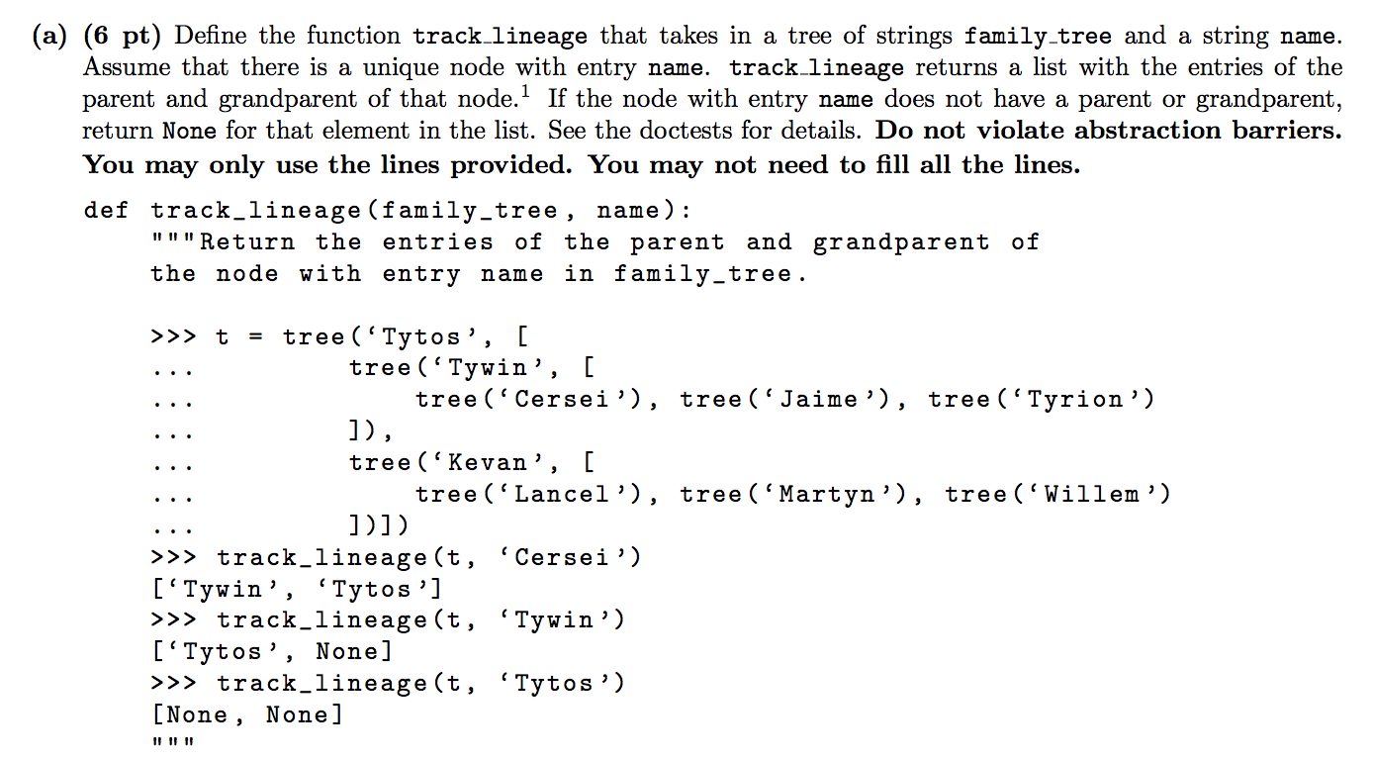

Slide 18
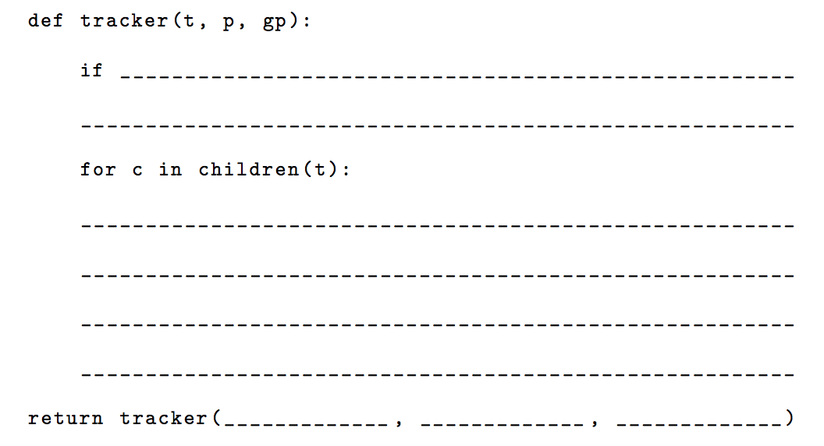

Slide 19
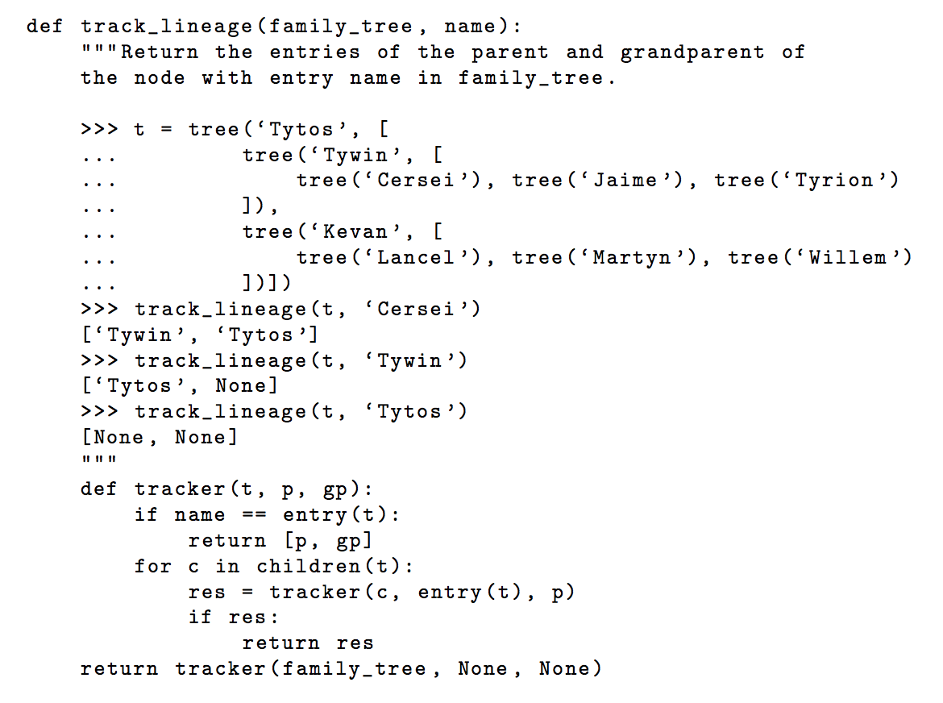

Slide 20
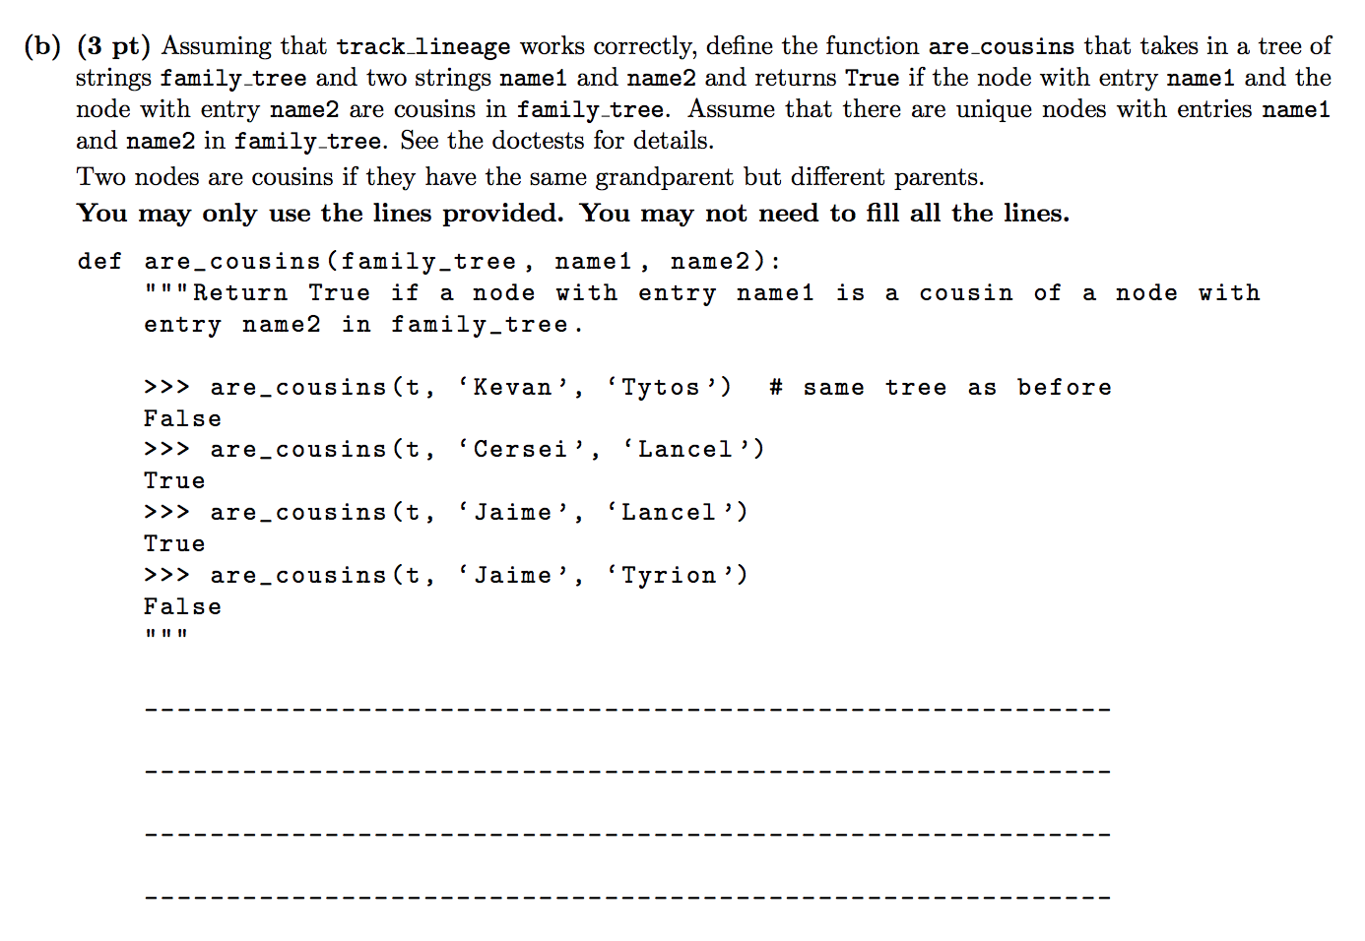

Slide 21
